Slide 1
Identity Based Encryption using KU-CSP
SRM University
Department of Computer Science and Engineering
Kattankullathur, Chennai , Tamil Nadu 603203

Slide 2
Name :- Ashish Jangu Reg No :- 1031210332 Branch :- CSE Name :- Prabhunath Yadav Reg No :- 1031210334 Branch :- CSE Under the guidance of Mr. M. RAJASEKARAN (Assistant Professor)

Slide 3
Objective Or Scope
Using Identity based reducing the overhead of PKG for generating key each time when user requests ,Implementing the functionality to KU-CSP for key generation for time list user and deactivate the revoked list users.

Slide 4
Problem Definition
As the number of users are exponentially increasing the burden of providing separate public key by PKG which cause bottleneck problem at PKG.
The burden to update private key and revocation of user on key compromise issues are the major problems of PKG

Slide 5
Modules of Project
Three Phases:
1. Users
2.PKG ( Private Key Generator )
3. KU-CSP(Key Update-Cloud Service Provider)

Slide 6
Users
1. User Registration
2. User Login
3. User Upload Files.
4. Request for allow access and private key from CSP.
5.Verify file access code and downloading.

Slide 7
PKG
1.First private key generation
2. Key outsourcing to CSP and User.
3.Encryption of Original data.

Slide 8
KU-CSP
1.Key Update
2.Send access code to users mail.
3.Verify users.
4.Allow access to time list users.
5.Maintain list of Revoked List users and Time list users.

Slide 9
RSA Algorithm
KEY GENERATE
public static void generateKey() {
try {
final KeyPairGenerator keyGen = KeyPairGenerator.getInstance(“RSA”);
keyGen.initialize(1024);
final KeyPair key = keyGen.generateKeyPair();
File privateKeyFile = new File(PRIVATE_KEY_FILE);
File publicKeyFile = new File(PUBLIC_KEY_FILE);
// Create files to store public and private key
if (privateKeyFile.getParentFile() != null) {
privateKeyFile.getParentFile().mkdirs();
}
privateKeyFile.createNewFile();
if (publicKeyFile.getParentFile() != null) {
publicKeyFile.getParentFile().mkdirs();
}

Slide 10
publicKeyFile.createNewFile();
// Saving the Public key in a file
// C:/keys/prubilc.key
ObjectOutputStream publicKeyOS = new ObjectOutputStream(
new FileOutputStream(publicKeyFile));
publicKeyOS.writeObject(key.getPublic());
publicKeyOS.close();
// Saving the Private key in a file //C:/keys/private.key
ObjectOutputStream privateKeyOS = new ObjectOutputStream(
new FileOutputStream(privateKeyFile));
privateKeyOS.writeObject(key.getPrivate());
privateKeyOS.close();
} catch (Exception e) {
e.printStackTrace();
}
}

Slide 11
Encryption
public static byte[] encrypt(String text, PublicKey key) {
byte[] cipherText = null;
try {
// get an RSA cipher object and print the provider
final Cipher cipher = Cipher.getInstance(ALGORITHM);
// encrypt the plain text using the public key
cipher.init(Cipher.ENCRYPT_MODE, key);
cipherText = cipher.doFinal(text.getBytes());
System.out.println("Key used to encrypt:"+key.toString());
} catch (Exception e) {
e.printStackTrace();
}
return cipherText;
}

Slide 12
Decryption
public static String decrypt(byte[] text, PrivateKey key) {
byte[] dectyptedText = null;
try {
// get an RSA cipher object and print the provider
final Cipher cipher = Cipher.getInstance(ALGORITHM);
// decrypt the text using the private key
cipher.init(Cipher.DECRYPT_MODE, key);
dectyptedText = cipher.doFinal(text);
System.out.println("Key used to Decrypt :"+key);
} catch (Exception ex) {
ex.printStackTrace();
}
return new String(dectyptedText);
}

Slide 13
User Registration
Class.forName("com.mysql.jdbc.Driver");
HttpSession se=request.getSession();
Connection con=DriverManager.getConnection("jdbc:mysql://localhost:3306/ibeorcc","root","password");
String message="";
String user_name,email,password,contact,location;
user_name=request.getParameter("user_name");
email=request.getParameter("email");
password=request.getParameter("password");
contact=request.getParameter("contact");
location=request.getParameter("location");
String query="insert into users (name, email, password,contact,location,status)values('"+user_name+"','"+email+"','"+password+"','"+contact+"','"+location+"','"+"False"+"')";
Statement pst=con.createStatement();
int x=pst.executeUpdate(query);

Slide 14
User Login
Class.forName("com.mysql.jdbc.Driver");
HttpSession se=request.getSession();
Connection con=DriverManager.getConnection("jdbc:mysql://localhost:3306/ibeorcc","root","password");
String loginmessage="";
String email,password;
email=request.getParameter("email");
password=request.getParameter("password");
String query="select * from users where email='"+email+"' and password='"+password+"'";
Statement pst=con.createStatement();
ResultSet rs=pst.executeQuery(query);
if(rs.next())
{
se.setAttribute("User_Email",email);
se.setAttribute("User_Password", password);
response.sendRedirect("user_profile.jsp");
}

Slide 15
PKG Login
Class.forName("com.mysql.jdbc.Driver");
Connection con= DriverManager.getConnection("jdbc:mysql://localhost:3306/ibeorcc","root","password");
String user_name=request.getParameter("user_name");
String password=request.getParameter("password");
String query="select * from pkg where user_name='"+user_name+"' and password='"+password+"'";
Statement st= con.createStatement();
ResultSet rs=st.executeQuery(query);
if(rs.next())
{
se.setAttribute("pkg_user", user_name);
se.setAttribute("password", password);
response.sendRedirect("pkg_home.jsp");
}

Slide 16
CSP Login
Class.forName("com.mysql.jdbc.Driver");
Connection con= DriverManager.getConnection("jdbc:mysql://localhost:3306/ibeorcc","root","password");
String user_name=request.getParameter("user_name");
String password=request.getParameter("password");
String query="select * from csp where user_name='"+user_name+"' and password='"+password+"'";
Statement st= con.createStatement();
ResultSet rs=st.executeQuery(query);
if(rs.next())
{
se.setAttribute("csp_user", user_name);
se.setAttribute("password", password);
response.sendRedirect("csp_home.jsp");
}

Slide 17
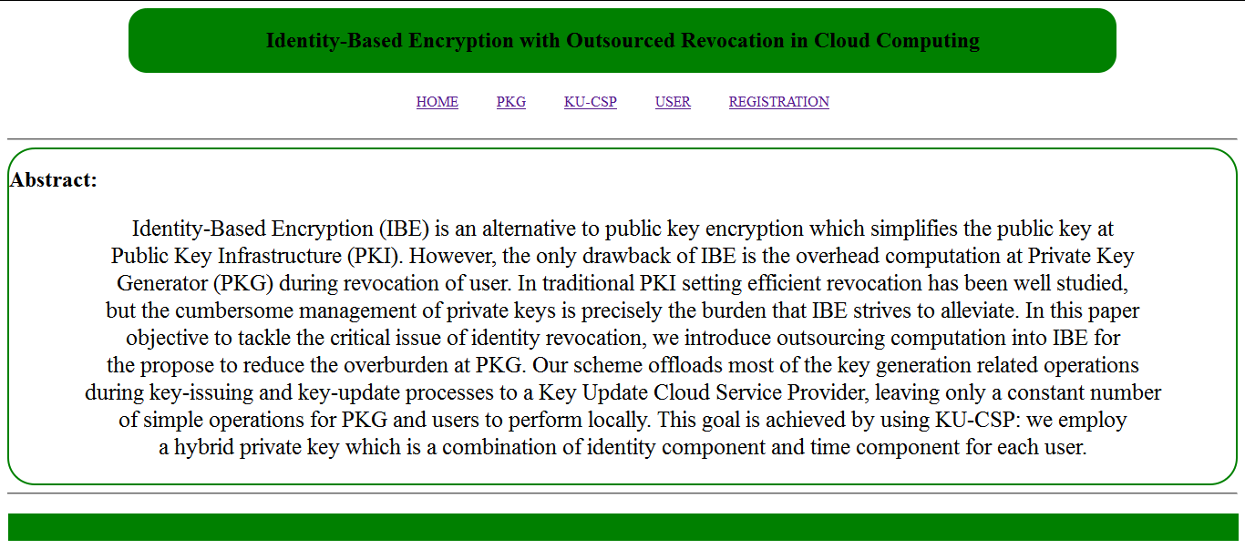
Output
Index page

Slide 18
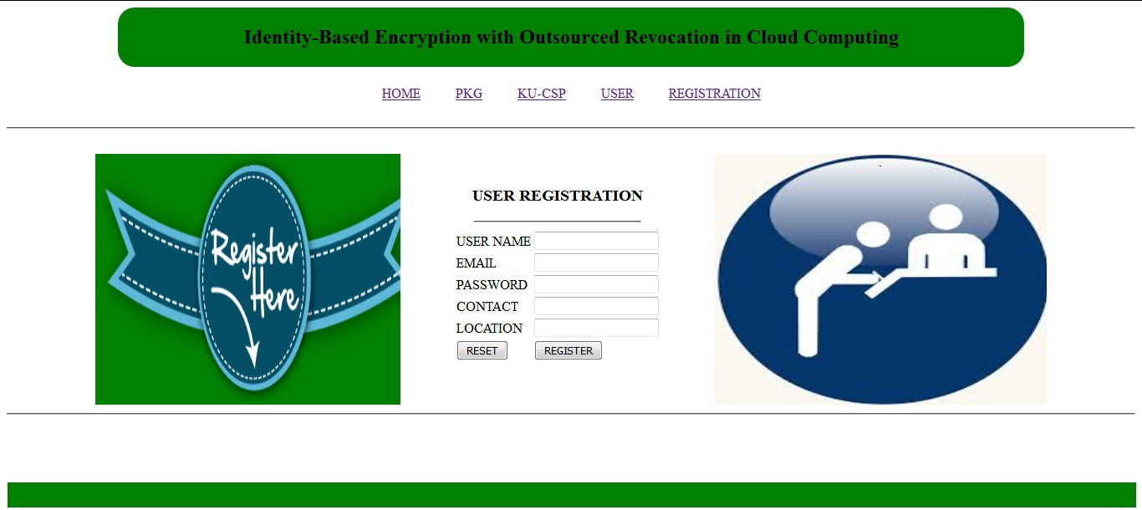
User Register

Slide 19
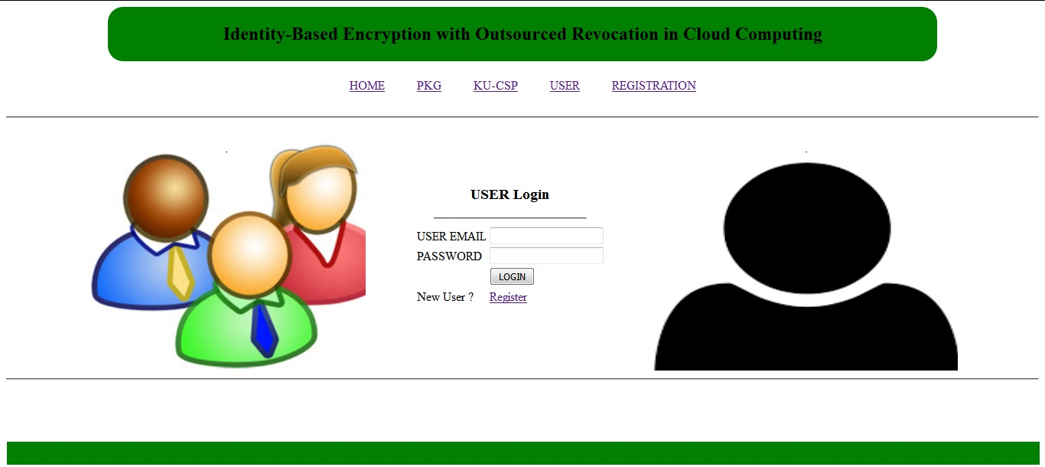
User Login page

Slide 20
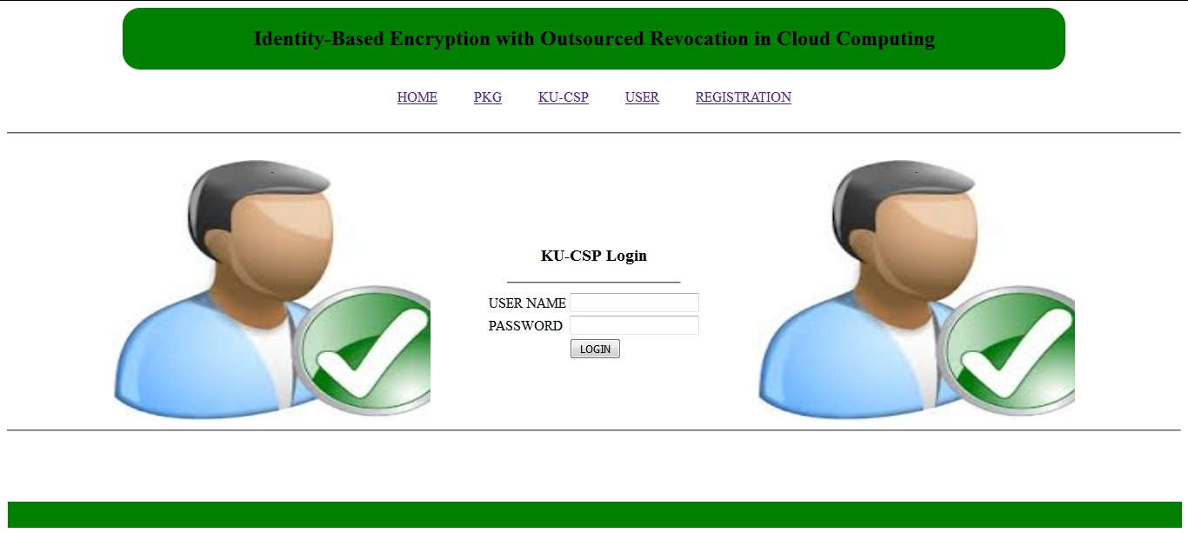
CSP Login page

Slide 21
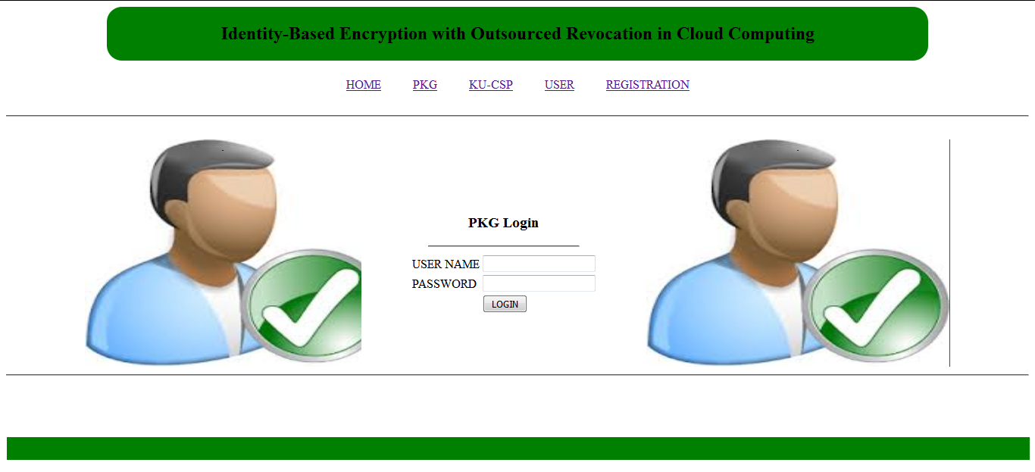
PKG Login

Slide 22
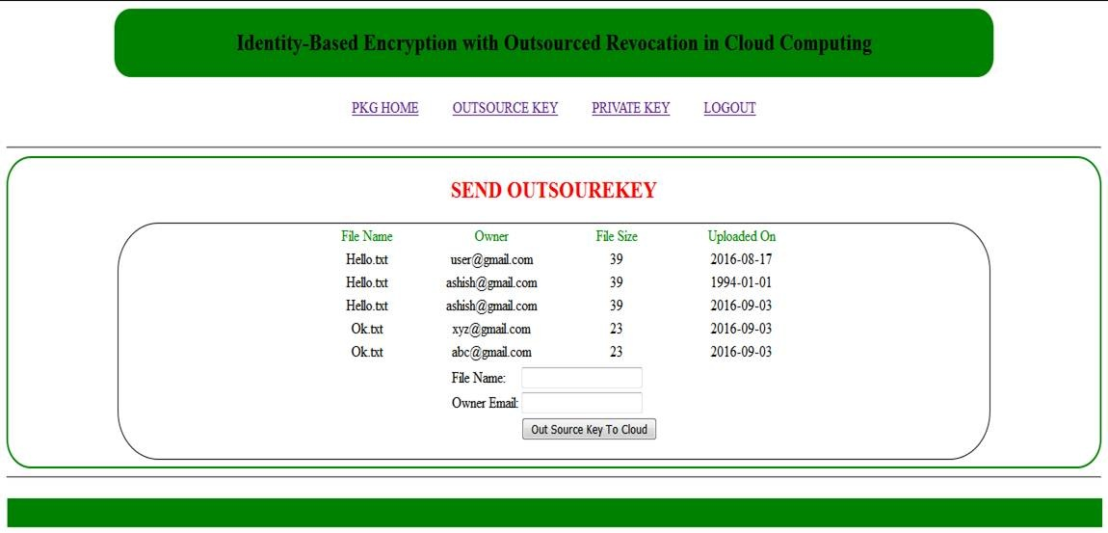
Send Outsource Key

Slide 23
Reference Papers
Identity-Based Encryption with Outsourced Revocation in Cloud Computing by:Jin Li, Jingwei Li, Xiaofeng Chen, Chunfu Jia, and Wenjing Lou, Senior Member, IEEE
W. Aiello, S. Lodha, and R. Ostrovsky, “Fast digital identity revocation,” in Advances in Cryptology (CRYPTO’98). New York, NY, USA: Springer, 1998, pp. 137–152.

Slide 24
Textbook Reference
Cloud Services FOR Dummmies IBM LIMITED EDITION

Slide 25
Website Reference
http://scanftree.com/programs/java/implementation-of-rsa-algorithmencryption-and-decryption-in-java/
http://www.oracle.com/technetwork/java/crypto-142375.html

Slide 26
Thank You!!

